Slide 1
Vikas Chandra

Slide 2
Cloud Basics
What is Cloud?
Public/Private/Hybrid
IaaS/PaaS/SaaS

Slide 5
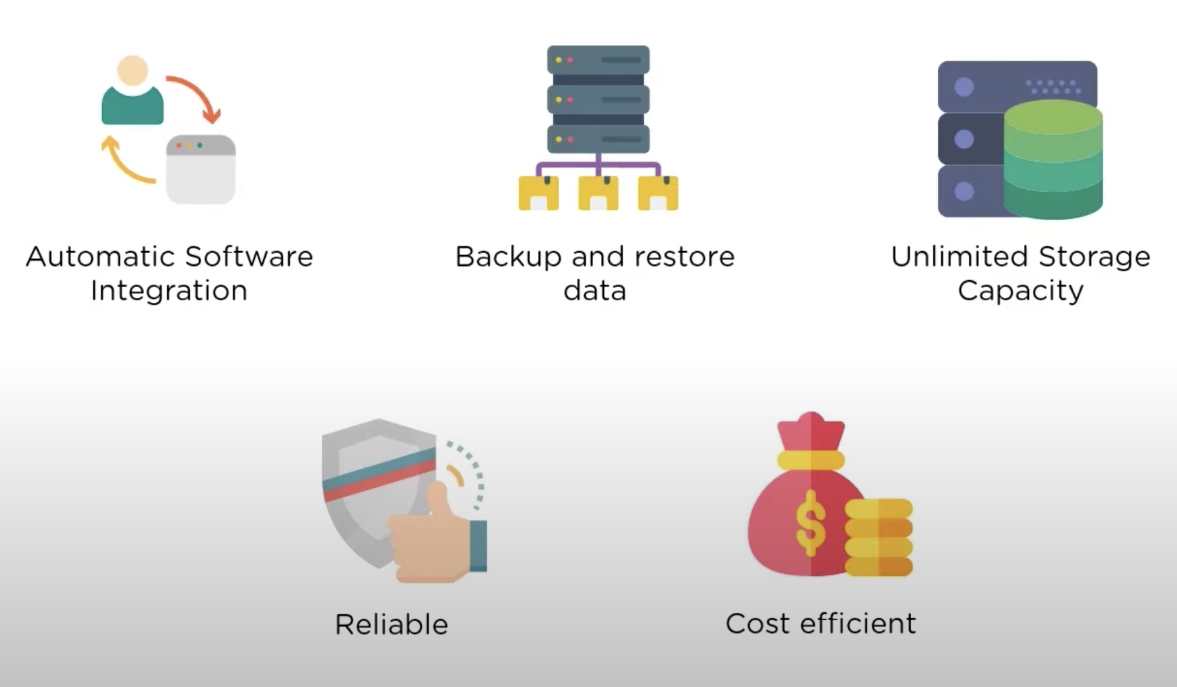
What is Cloud Computing?

Slide 6
Cloud Providers

Slide 7
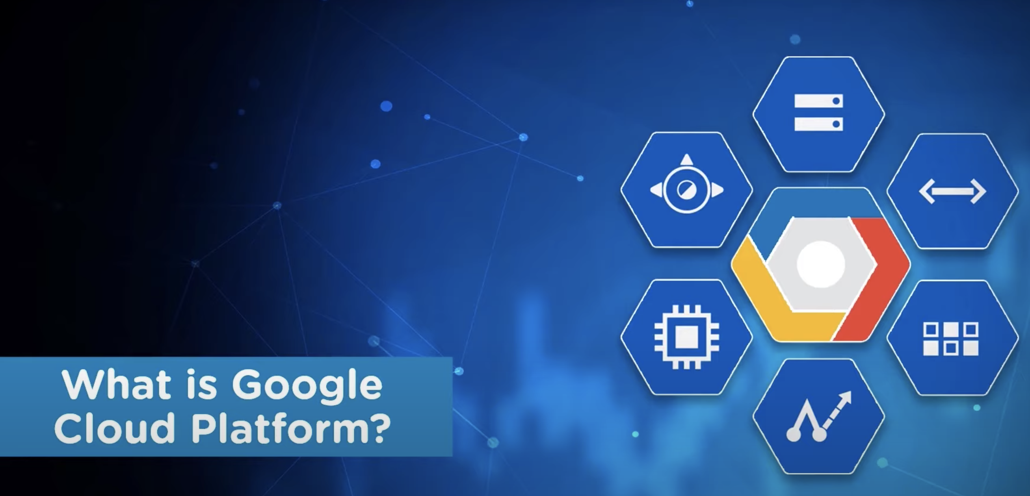

Slide 8
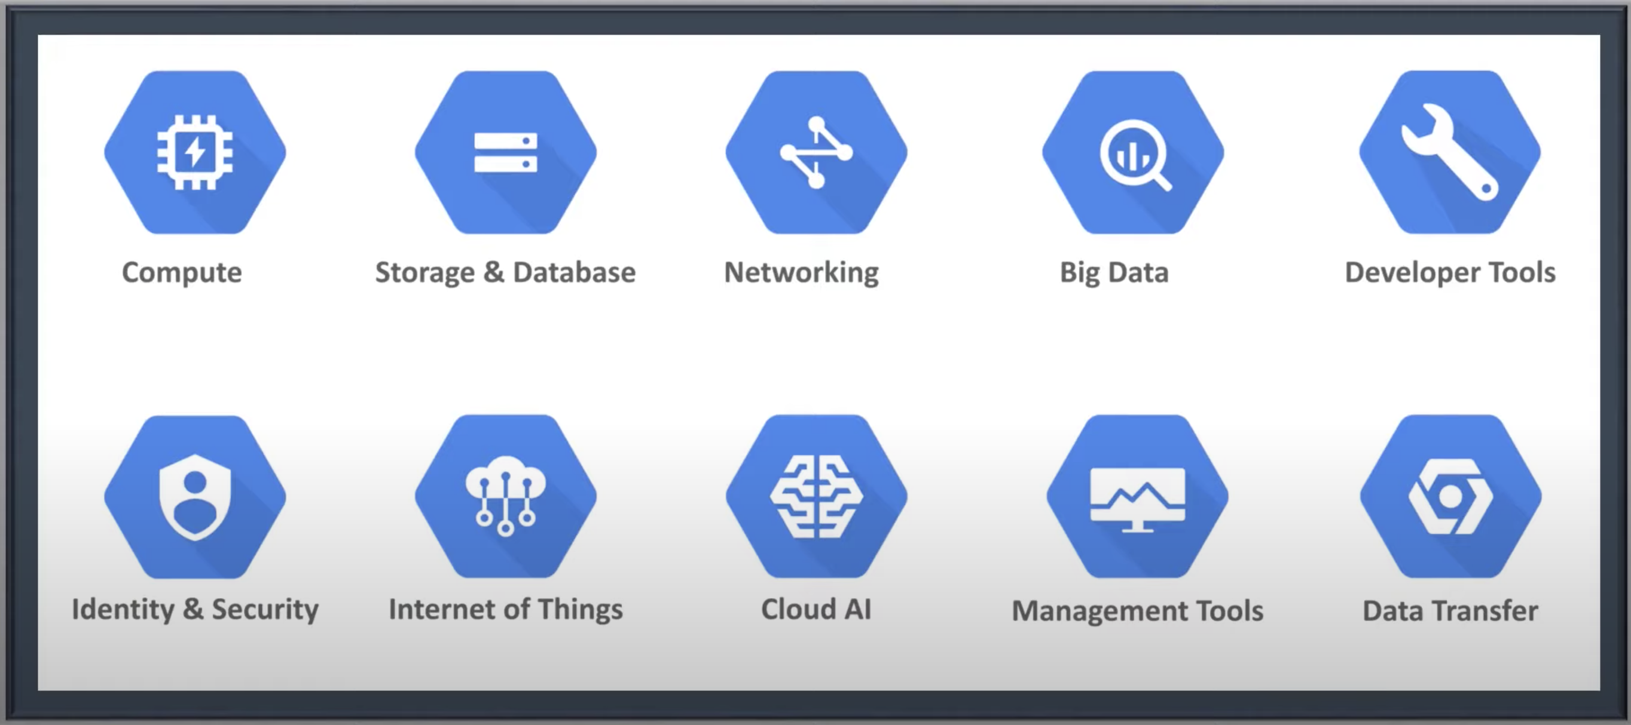
Google Cloud Platform Domains

